Slide 1
Azure Site Recovery
Your secret weapon to get you to the cloud
Notes:
© Copyright PresentationGo.com – The free PowerPoint library

Slide 2


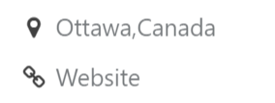
Eric Leonard
Solutions Architect
Cistel Technology Inc.
Twitter: @erleonard
LinkedIn: https://www.linkedin.com/in/erleonard/
Website: http://erleonard.me
GitHub: https://github.com/erleonard

Slide 3
Agenda
Why would I use Azure Site Recovery?
What do I need to use Azure Site Recovery?
Can I automate it?
Demos

Slide 4
Definitions
RPO
Disaster
RTO
How far back?
How long to recover?
Recovery Point Objective (RPO) |  | Recovery Time Objective (RTO)
The acceptable amount of data loss measured in time. |  | The duration of time within which a business process must be restored after disaster (or disruption) in order to avoid unacceptable consequences associated with a break in business continuity.
Notes:
RPO: Up to what point in time could the Business Process’s recovery proceed tolerably given the volume of data lost during that interval?
RTO: How much time did it take to recover after notification of business process disruption?

Slide 5
Why Use ASR
Simple
Setup can be achieved in a few hours
Ease of Use
Replication
Orchestration
Affordable
First 31 days is Free
Test your recovery plans
Reduces the need for secondary data centers
Notes:
Cost: https://azure.microsoft.com/en-ca/pricing/details/site-recovery/
https://azure.microsoft.com/en-ca/regions/services/
Azure as a secondary data center reduces the costs of building and maintaining a secondary site.

Slide 6
Use Case
Planned failover (Business Continuity Testing) | Unplanned Failover (Disaster Recovery) | Test Failover (Testing/Staging/UAT) | Lift and Shift
Zero data loss for the application when a planned activity is performed No impact on the ongoing replication or on your production environment. | Minimal data loss for the application | Test failover to validate your replication strategy or perform a disaster recovery drill without any data loss or downtime. No impact on the ongoing replication or on your production environment. | Move your application to the cloud with no data loss.
Notes:
Failover Types: test, planned and unplanned

Slide 7
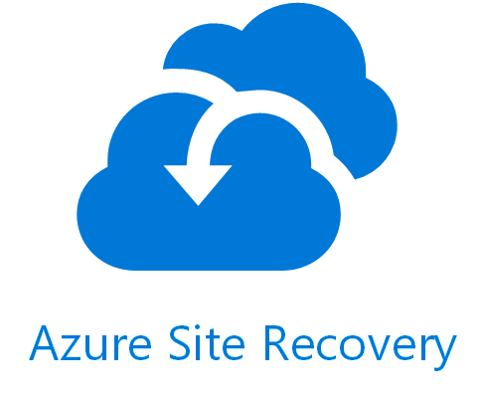


Supported Operating System
Supported requirements for replicated machines
HYPER-V
Any guest OS supported by Azure.
Any guest OS supported by Hyper-v
VMWARE or PHYSICAL
2008 R2 SP1 64 bit and above
Red Hat Enterprise Linux 6.7, 7.1, 7.2 Centos 6.5, 6.6, 6.7, 7.0, 7.1, 7.2 Oracle Enterprise Linux 6.4, 6.5 SUSE Linux Enterprise Server 11 SP3
Supported OS for virtualization
management server
vCenter 6.5, 6.0 or 5.5
System Center Virtual Machine Manager 2012 R2
System Center Virtual Machine Manager 2016
Supported OS for virtualization host server
vSphere 6.5, 6.0 or 5.5
Windows Server 2012 (R2)
Windows Server 2016
Windows Server
https://docs.microsoft.com/en-us/azure/site-recovery/site-recovery-support-matrix-to-azure
Notes:
Running Windows Server 2003 on Microsoft Azure: https://support.microsoft.com/en-ca/help/3206074

Slide 8
Workload | Replicate Hyper-V VMs to a secondary site | Replicate Hyper-V VMs to Azure | Replicate VMware VMs to a secondary site | Replicate VMware VMs to Azure
Active Directory, DNS | Y | Y | Y | Y
Web apps (IIS, SQL) | Y | Y | Y | Y
System Center Operations Manager | Y | Y | Y | Y
SharePoint | Y | Y | Y | Y
SAP Replicate SAP site to Azure for non-cluster | Y (tested by Microsoft) | Y (tested by Microsoft) | Y (tested by Microsoft) | Y (tested by Microsoft)
Exchange (non-DAG) | Y | Y | Y | Y
Remote Desktop/VDI | Y | Y | Y | N/A
Linux (operating system and apps) | Y (tested by Microsoft) | Y (tested by Microsoft) | Y (tested by Microsoft) | Y (tested by Microsoft)
Dynamics AX | Y | Y | Y | Y
Dynamics CRM | Y | Coming soon | Y | Coming soon
Oracle | Y (tested by Microsoft) | Y (tested by Microsoft) | Y (tested by Microsoft) | Y (tested by Microsoft)
Windows File Server | Y | Y | Y | Y
Citrix XenApp and XenDesktop | N/A | Y | N/A | Y

Slide 9


Disaster Recovery for Hyper-V
Hyper-V Server
443 (HTTPS)
Data Channel
Public Internet or ExpressRoute
Source: Hyper-V
Microsoft Azure Recovery Services Agent
Replicates data to Azure

Slide 10
Disaster Recovery for VMM
VMM Server
ASR Provider
443 (HTTPS)
Microsoft Azure
Hyper-V Servers
Data Channel
Public Internet or ExpressRoute
Source: Hyper-V
Microsoft Azure Recovery Services Agent
Replicates data to Azure

Slide 11

Disaster Recovery for VMware/Physical
443 (HTTPS)
Config Server
Process Server
9443 (HTTPS)
443 (HTTPS)
Data Channel
Public Internet or ExpressRoute
Source: VMware & Physical Servers
Process Server
Used for caching, compression, and encryption
Configuration Server
Used for centralized management
Mobility Service Captures all data writes from memory

Slide 12
DEMO
Create Recovery Vault
Notes:
Azure storage and networking

Slide 13
DEMO
Create Recovery Plan
Notes:
Azure storage and networking

Slide 14
Automation
Integrate Azure Automation Runbooks with ASR
Orchestrate recovery of VMs that are protected with Site Recovery
Sample Scripts: https://github.com/Azure/azure-quickstart-templates/tree/master/asr-automation-recovery
Notes:
https://docs.microsoft.com/en-us/azure/site-recovery/site-recovery-runbook-automation

Slide 15
Automation Example
Start
Failover Domain Controllers
Execute AD Check Runbook
Failover SQL Servers
Manual approval
Failover Web Servers
Send Completed Email
Execute Check Runbook

Slide 16
DEMO
Customize Recovery Plan
Notes:
Application-consistent snapshots use Volume Shadow Copy Service (VSS) to ensure that applications are in a consistent state when the snapshot is taken.

Slide 17
Azure Site Recovery Reporting and Monitoring
Azure Backup Reports using Power BI
Operations Management Suite (OMS)
Azure Portal

Slide 18
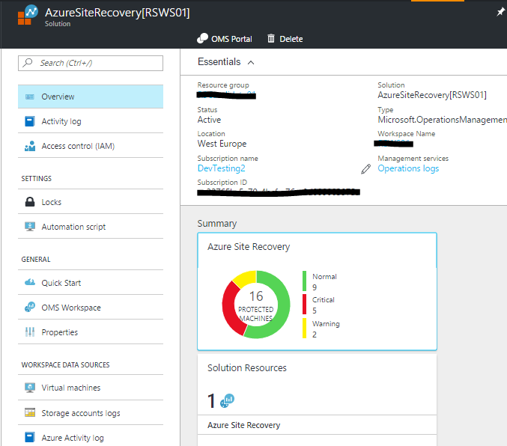
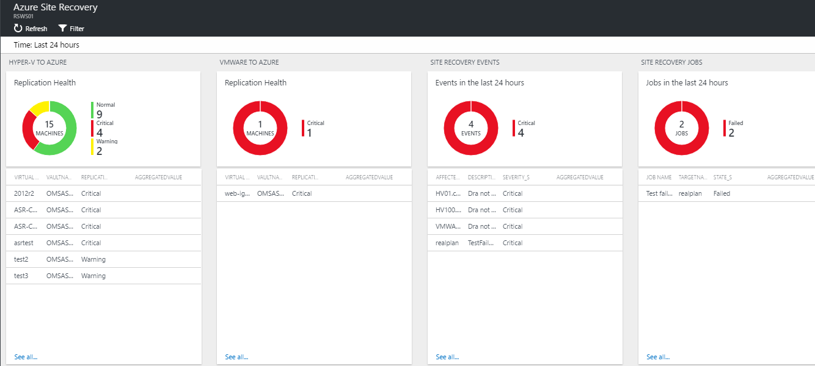
OMS

Slide 19

Questions

Slide 20
ASR to Secondary Site
VMM Server
ASR Provider
VMM Server
ASR Provider
443 (HTTPS)
Hyper-V Servers
Hyper-V Servers
Microsoft Azure Recovery Services Agent
Replicates data to Azure
Primary Site
Secondary Site
Notes:
Site Recovery

Slide 21
Reduce RTO by using Azure Traffic Manager

